Slide 1
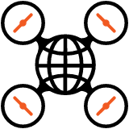
Aerial Images to Maps
Technological Advancements with OpenDroneMap

Slide 2
What is OpenDroneMap?

Slide 3
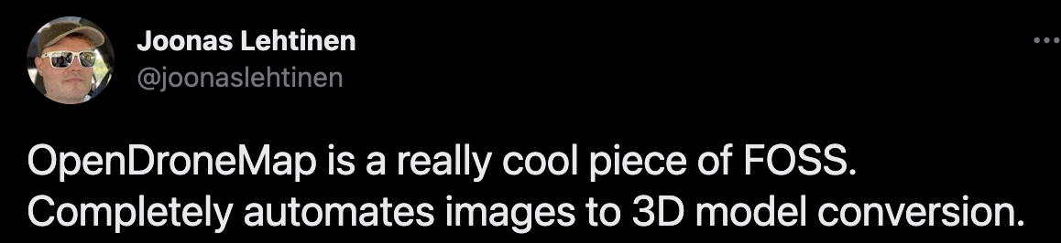
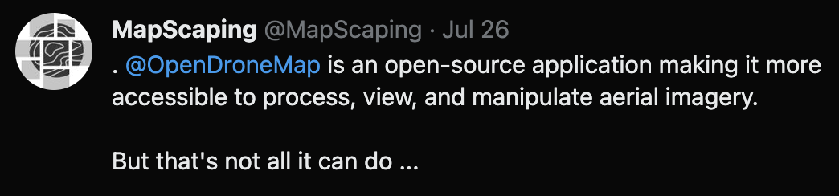

What is OpenDroneMap?

Slide 4
What is OpenDroneMap?
An ecosystem of tools
FOSS
Actively developed
Well supported
Well documented
Comparable or better than proprietary alternatives
A friendly community
Available on opendronemap.org

Slide 5
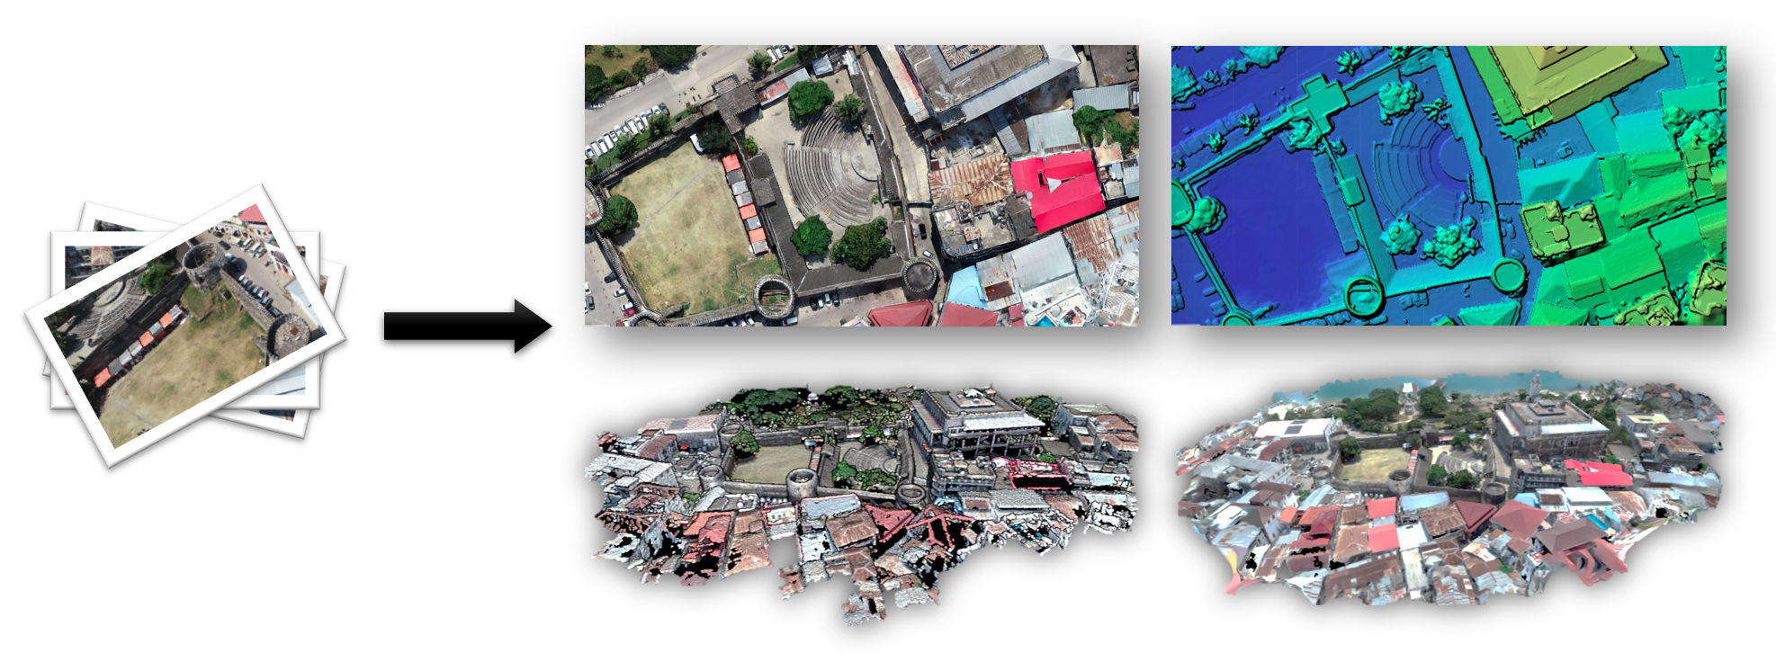
What is OpenDroneMap?
Mji Mkongwe, Stone Town, Zanzibar, Tanzania. Federico Debetto, KMedia SAS

Slide 6
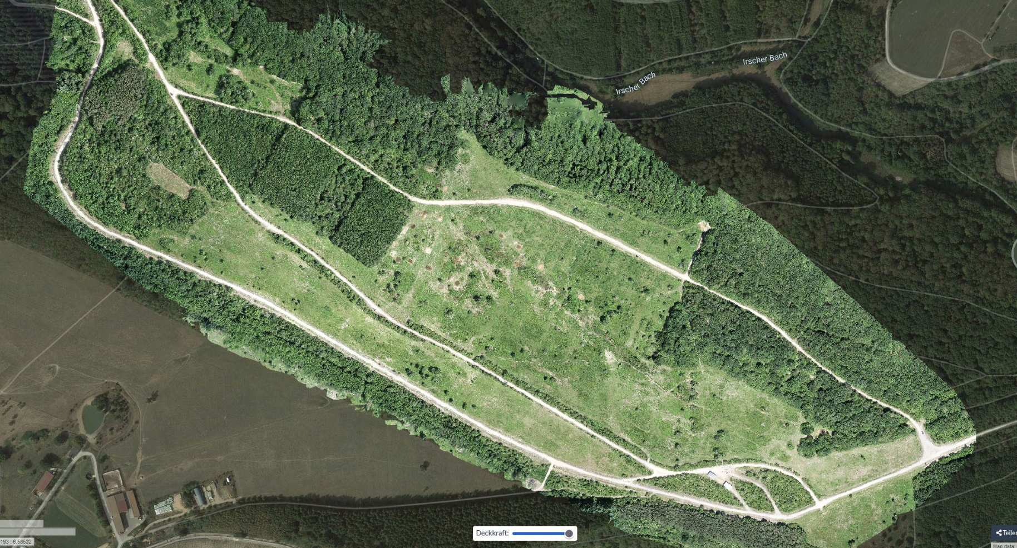
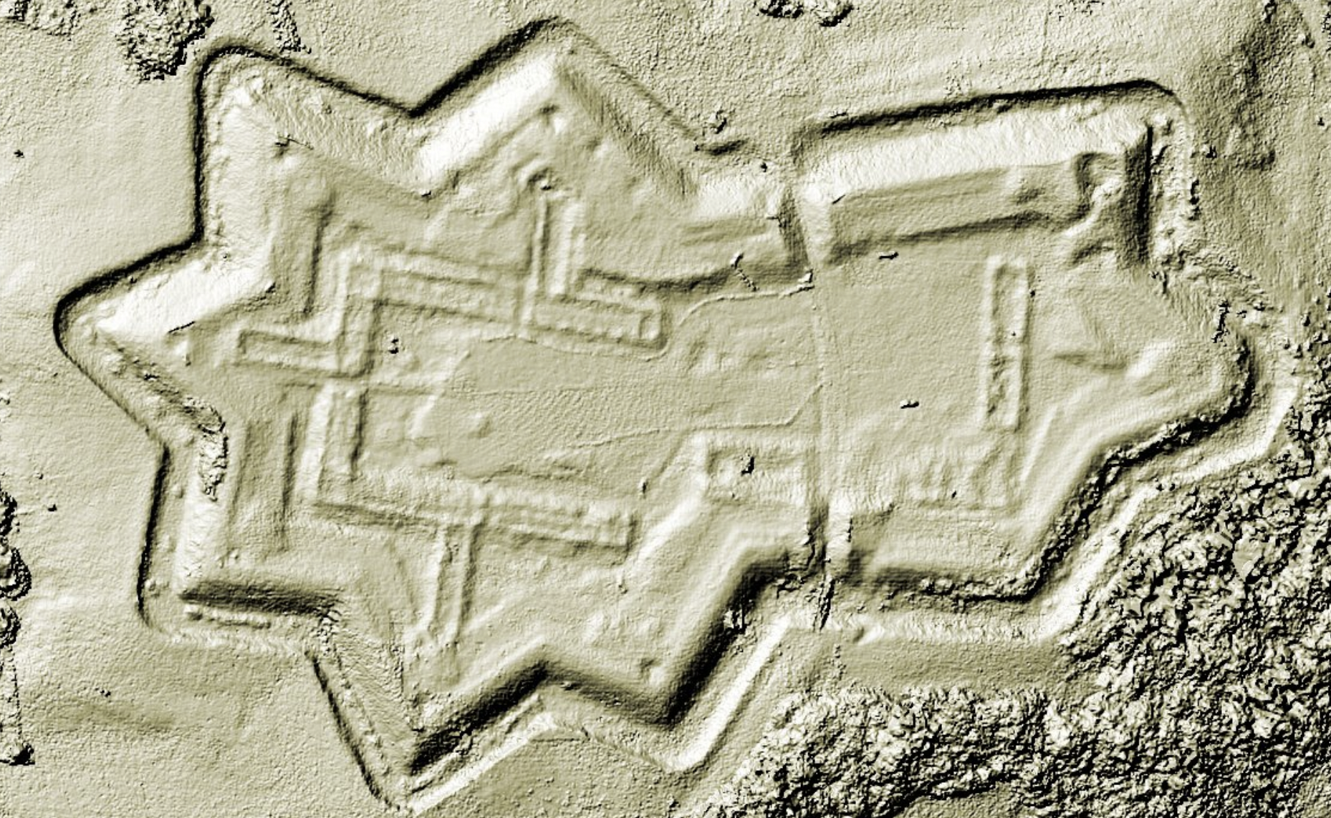
What is OpenDroneMap?
70 hectares grazing project with Longhorn cattle and Konik horses for nature conservation | credits: @sven_s8
Digital Surface Model | credits: @TomaszNycz

Slide 7
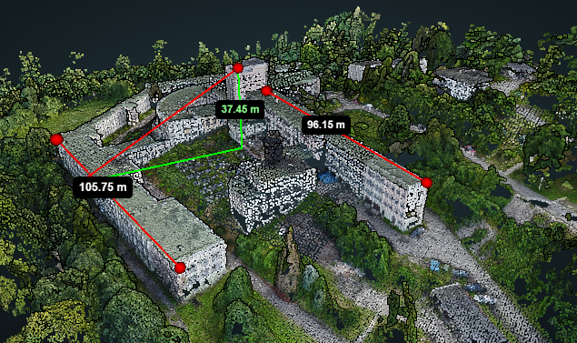
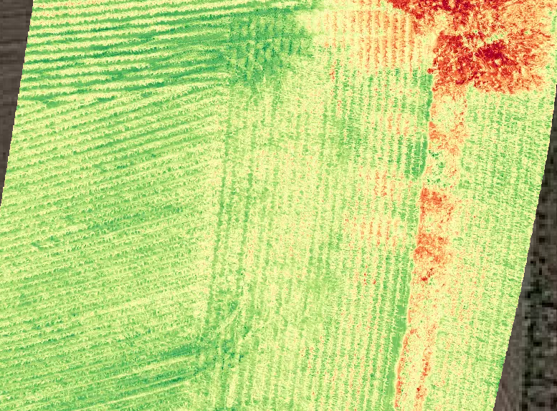
What is OpenDroneMap?
Structural measurements | credits: @TomaszNycz
Normalized difference vegetation index | credits: @aeret

Slide 8
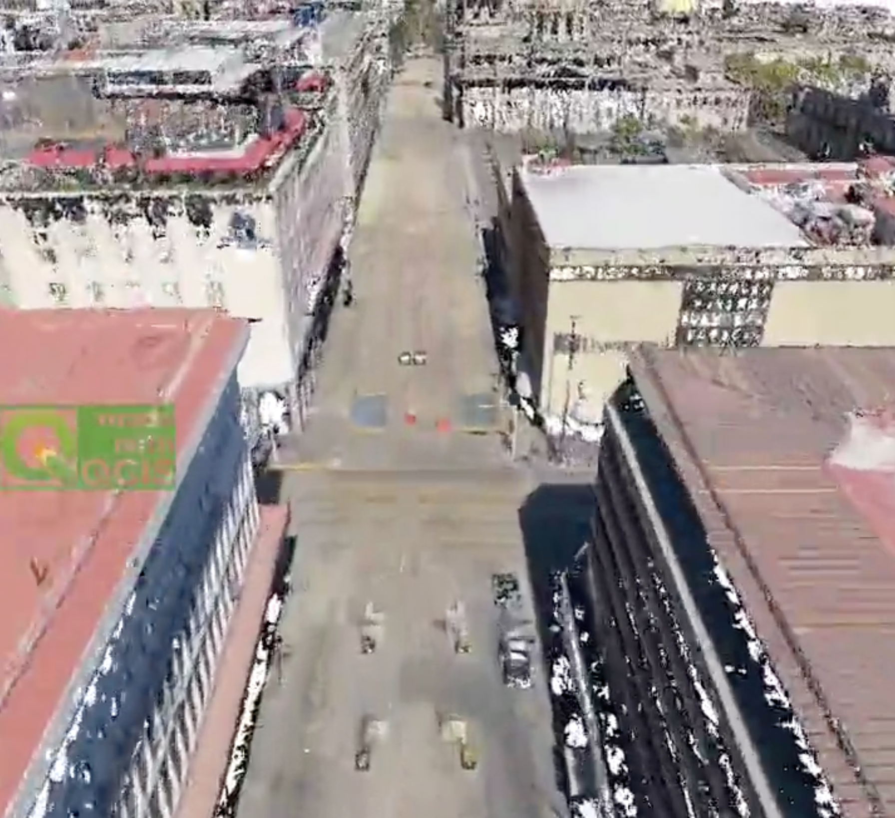
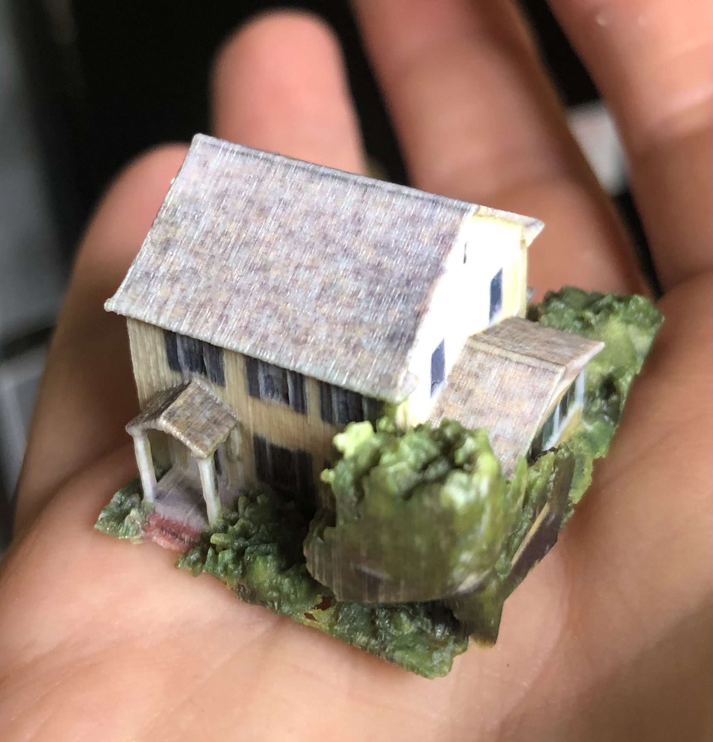
What is OpenDroneMap?
1,4 billion COPC opened in QGIS | credits: @hbecerra
3D printed house | credits: @smathermather

Slide 9
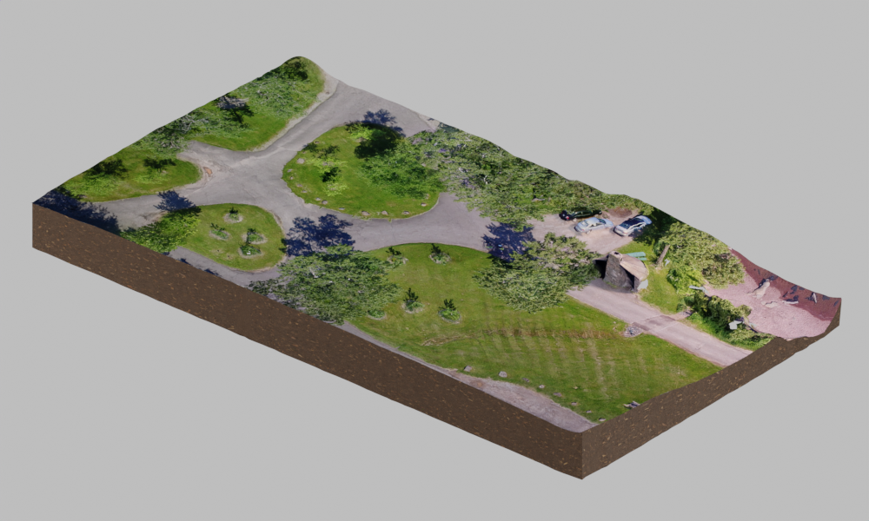
What is OpenDroneMap?
Brighton Beach 3D model + some Blender cleanup

Slide 10
How Get Started
Get a drone (any drone), capture some images
Or use some test data: opendronemap.org/datasets
Download the software
Follow the instructions on docs.opendronemap.org
Or help fund the development by purchasing an installer (49€, one time) from opendronemap.org
Select the images, go get an espresso (we're in Italy after all...)

Slide 11
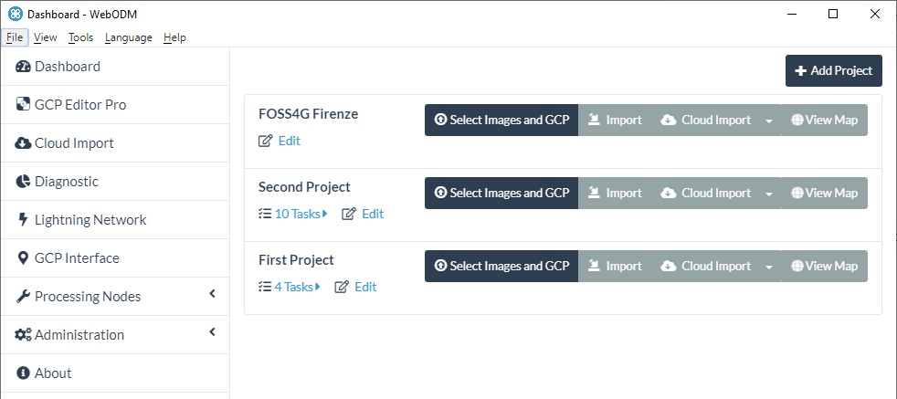
How To Get Started

Slide 12
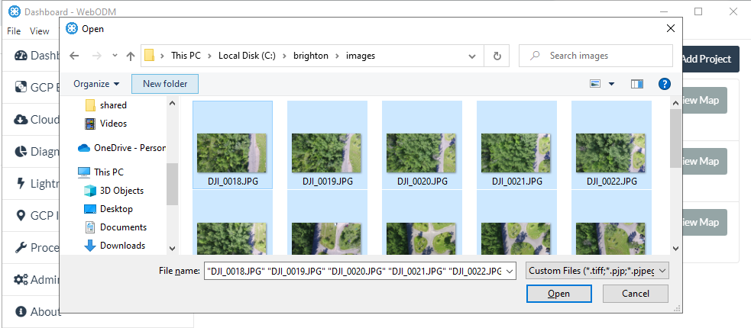
How To Get Started

Slide 13
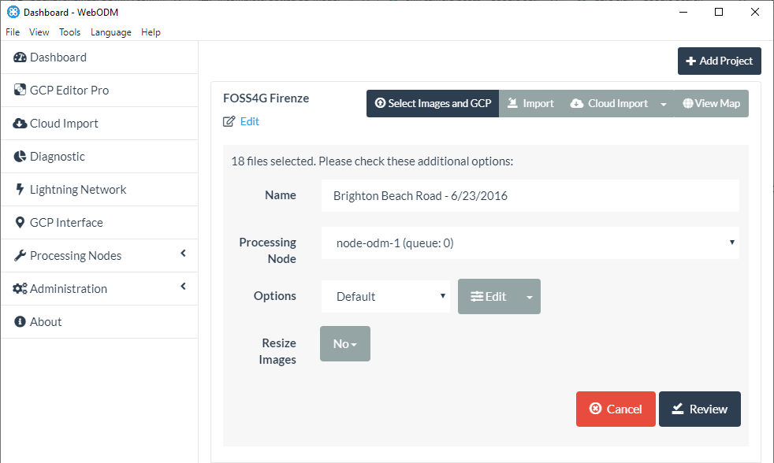
How To Get Started

Slide 14
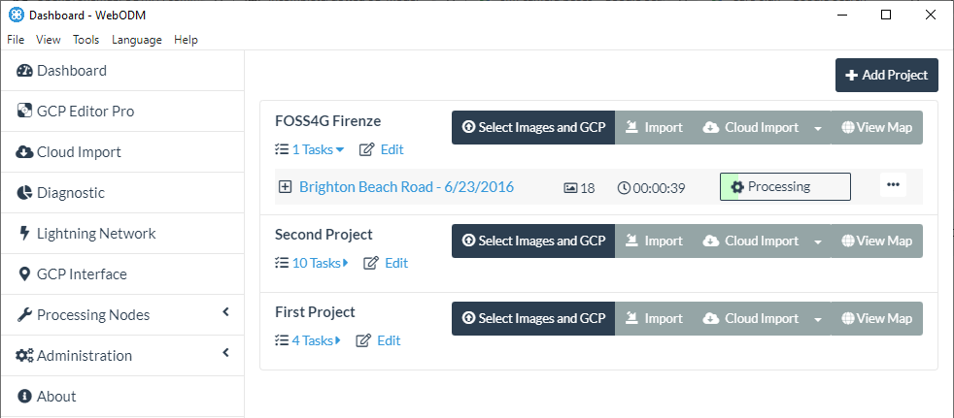
How To Get Started

Slide 15
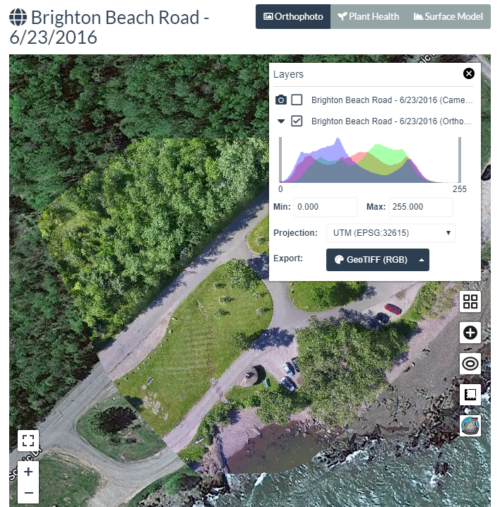
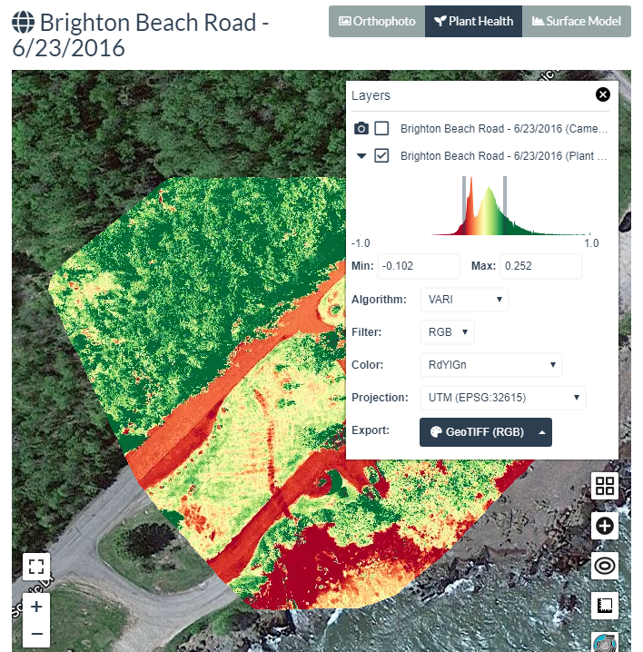
How To Get Started

Slide 16
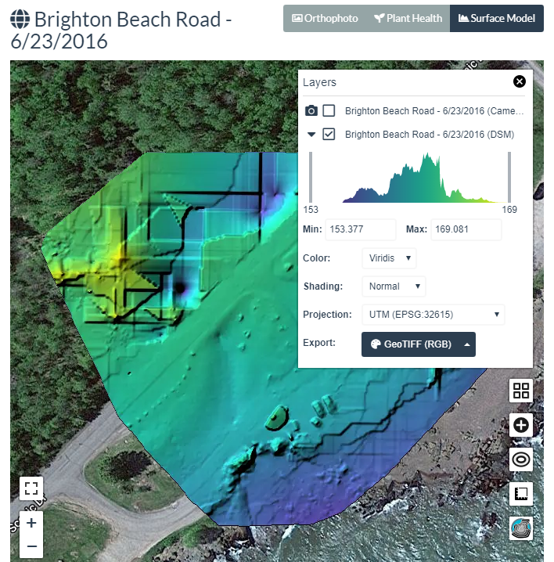
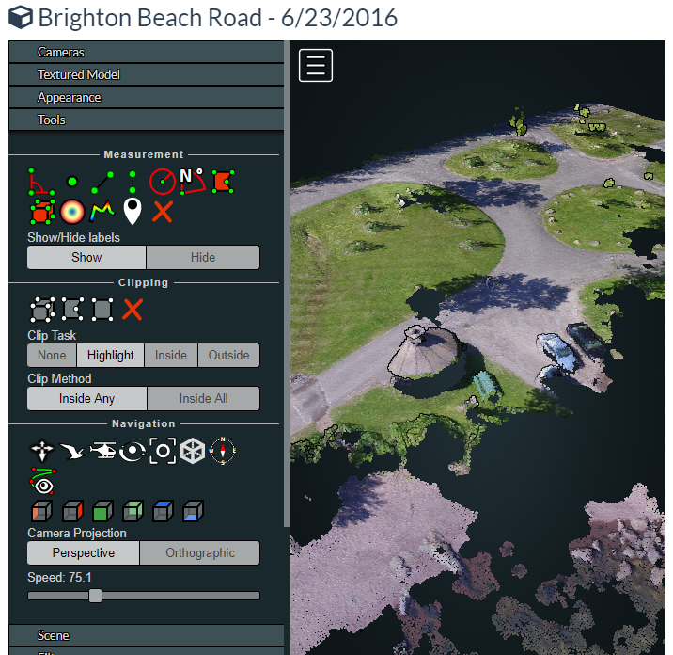
How To Get Started

Slide 17
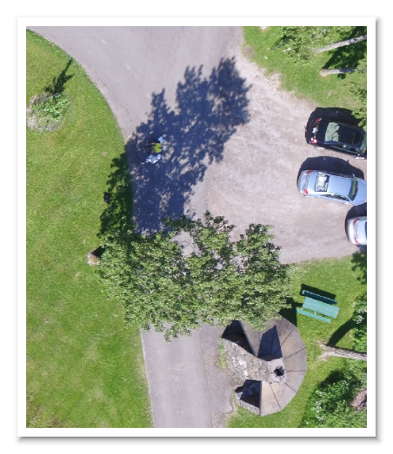
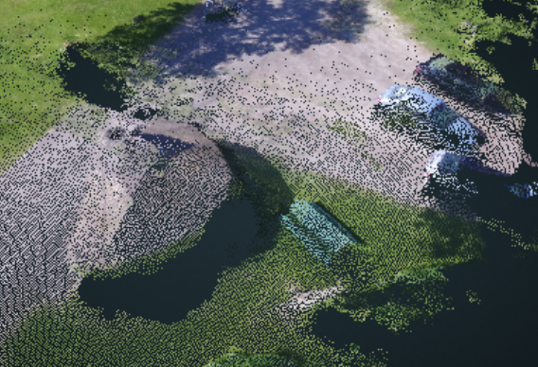
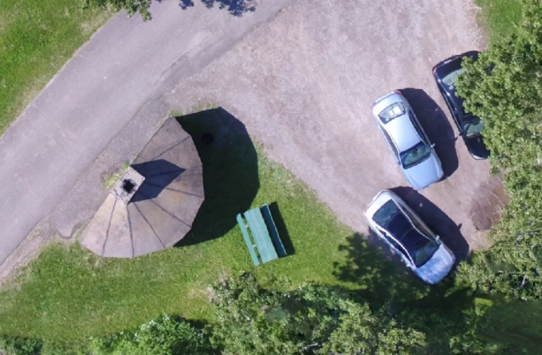
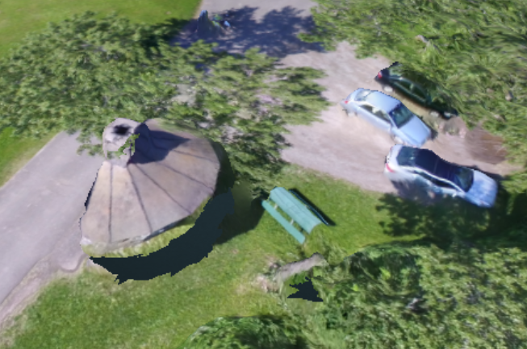
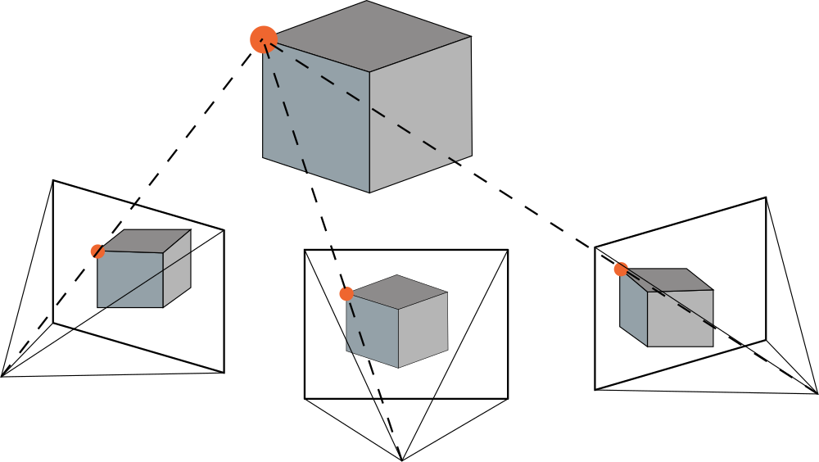
How it works (in a nutshell)
Images
SFM
Camera Poses
MVS
Point Cloud
Mesh + Texturing
Map

Slide 18
What's New

Slide 19
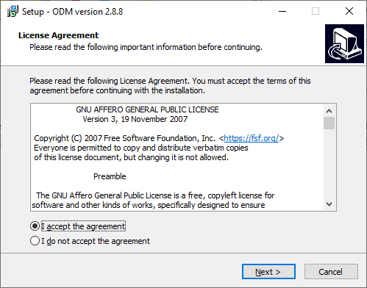
What's New
ODM Windows Native Support
Binary releases from github.com/OpenDroneMap/ODM/releases
No longer requires docker

Slide 20
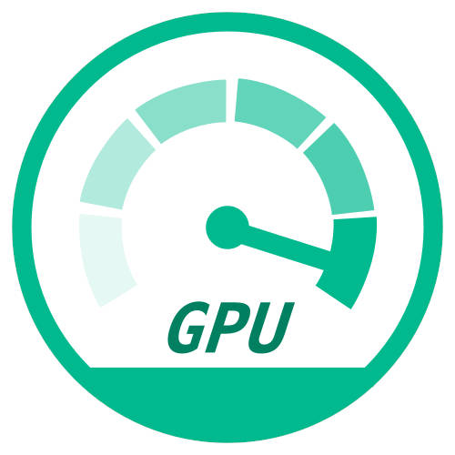
What's New
GPU Acceleration
Massive speed up in point cloud generation (10x)
NVIDIA only (for now..)
Enabled by default on Windows
Use opendronemap/odm:gpu docker image

Slide 21
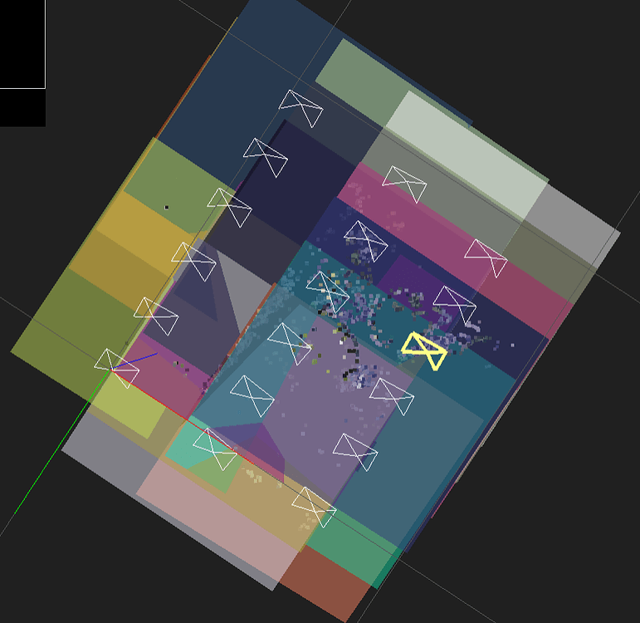
What's New
Planar Reconstructions (AG fields)
Requirements: flat terrain, fixed altitude, nadir camera shots
Massive speed-ups (~7x)
Enable via --sfm-algorithm planar

Slide 22
What's New
Denser, More Accurate Point Clouds (credit to OpenMVS)
Best verifiable benchmark score on tanksandtemples.org
Geometric refinement (enable via --pc-geometric)

Slide 23
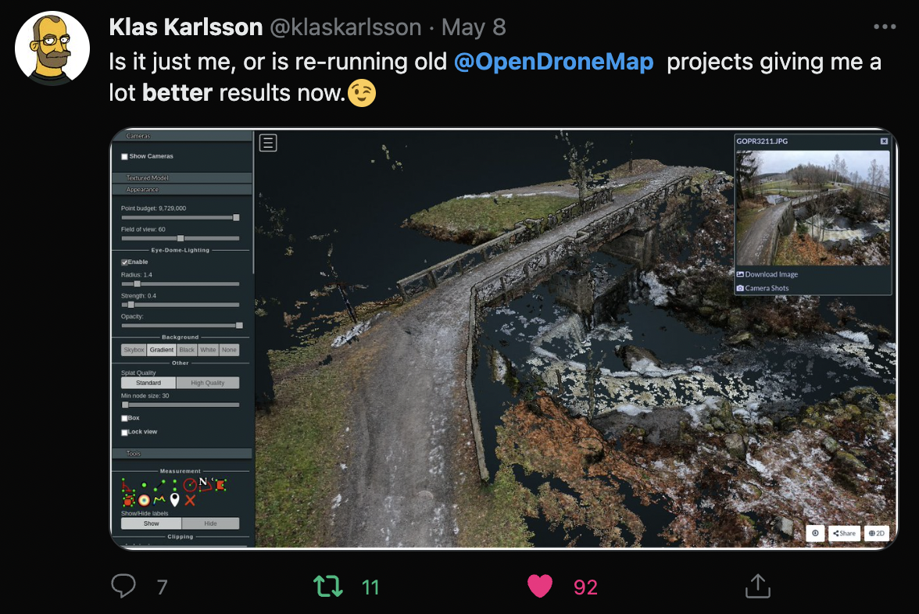

Slide 24
What's New
Multispectral Support
State-of-the-art automatic band alignment
Camera support
Sentera
MicaSense
DJI
Mixed 8bit RGB + 16bit TIFFs
Automatic radiometric calibration
Enable via --radiometric-calibration

Slide 25
What's New
Thermal Support
Working in ODM
Experimental WebODM support via "Plant Health"

Slide 26
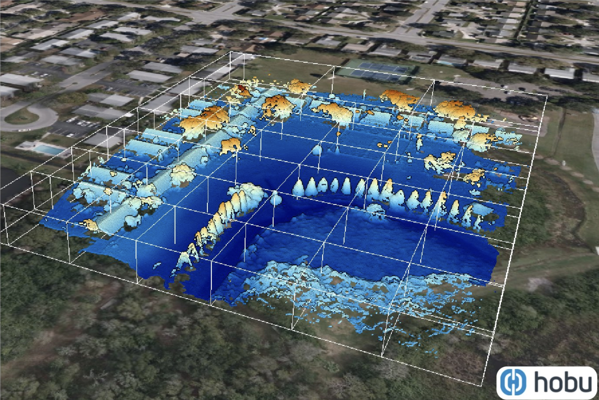
What's New
Cloud-Optimized Point Clouds
copc.io
Enable via --pc-copc

Slide 27
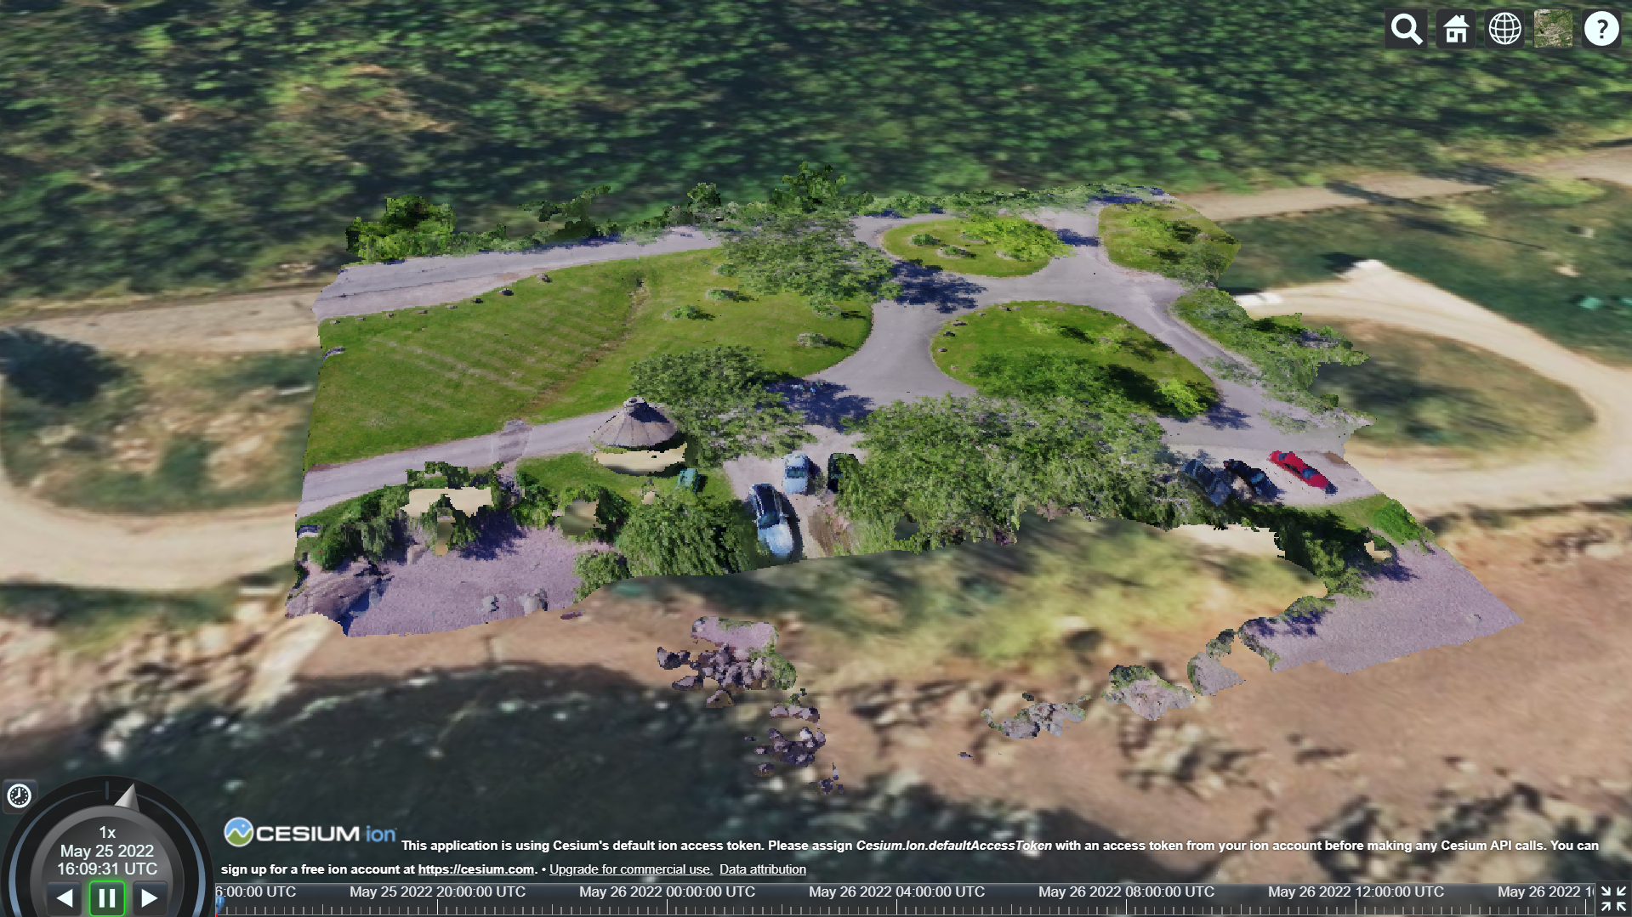
What's New
OGC 3D Tiles Generation (Cesium)
Hierarchical Level of Detail (HLOD) 3D Meshes
github.com/OpenDroneMap/Obj2Tiles
Point Clouds
Enable via --3d-tiles

Slide 28
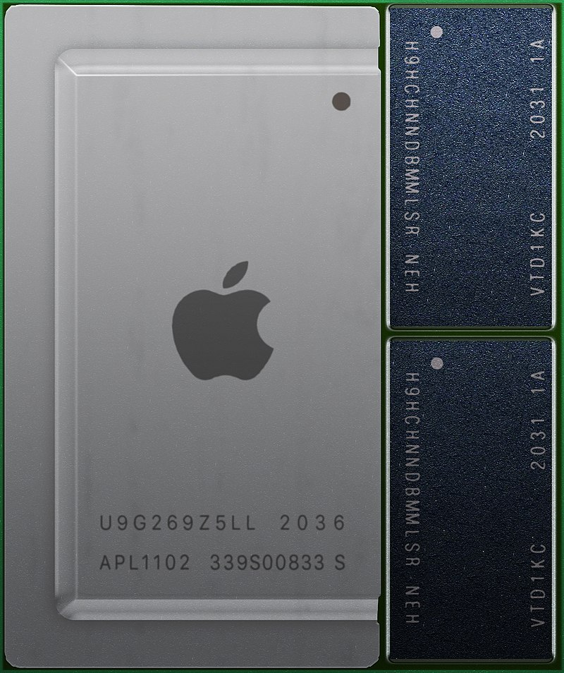
What's New
ARM64 Support
Apple M1/M2 (via docker)
ARM servers
Credit: Wikipedia @Henriok

Slide 29
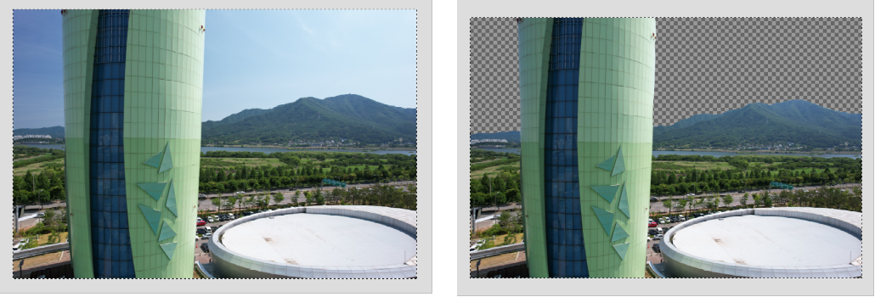
What's New
Smart Filtering Techniques
AI-based Automated Sky Removal
Enable via --sky-removal
Automated cropping based on shots boundaries
Enable via --auto-boundary

Slide 30
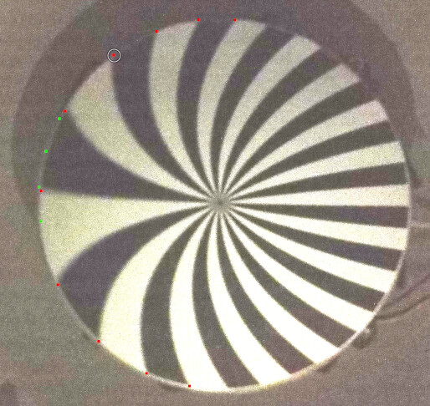
What's New
Rolling Shutter Correction
Implementation of "A two-step approach for the correction of rolling shutter distortion in UAV photogrammetry" by Y. Zhou et al
Rolling shutter readout database
Enable via --rolling-shutter
Readout time not in database? github.com/OpenDroneMap/RSCalibration

Slide 31
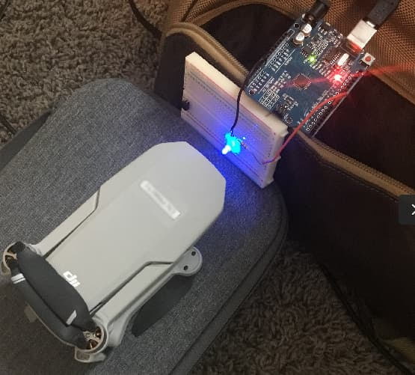
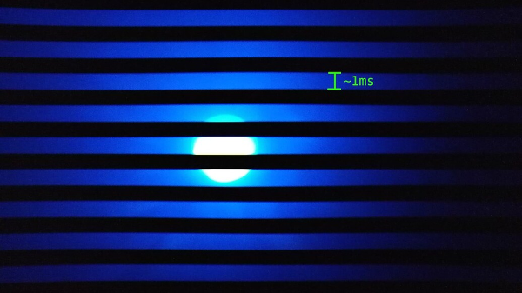
What's New

Slide 32
A Global Effort
Not a complete list
OpenSfM (Mapillary): Pau Gargallo, Yann Noutary
OpenMVS (3DNovator): Dan Cernea
PDAL (Hobu): Howard Butler, Andrew Bell, Connor Manning
Potree: Markus Schütz
Leaflet: Volodymyr Agafonkin
rio-tiler (Development Seed): Vincent Sarago
PoissonRecon (Johns Hopkins University): Michael Kazhdan
GDAL (OSGEO): Even Rouault
MVS Texturing (nFrames GmbH): Nils Moehrle
Countless others
You! opendronemap.org/get-involved

Slide 33
Our Approach
People before code
To accept a code contribution
Does it break?
Yes
Provide friendly help
No
Accept it
No but! Accept it
(You can always make changes later)
But... !

Slide 34
Our Approach
Do
Merge pull requests quickly
Encourage people to open pull requests
Don't:
Ask for changes (unless broken or out of scope)
Takes effort, but worth it.

Slide 35
One Final Surprise...

Slide 36
Years in the making...

Slide 37
Announcing...

Slide 38
OpenDroneMap
(the org)
*Not an official/final logo
Incorporated in Ohio, United States
August 11th 2022
Stay tuned...

Slide 39
Questions

